Slide 1
Team Programming: Sorting
Tarun, Justin, William

Slide 2

Our Approach
We decided to put all sorts into into one file and have the main program display all of them.
We put all of our arrays in the main program, using 4 different ones:
- An almost sorted array
- A randomly sorted array
- A reverse sorted array
- An array with many duplicates
We displayed the end results of the arrays being sorted while displaying which sort we used and the number of compares that were used to sort each array.

Slide 3
Our Approach (Alternative)
Step 1 Title
Step 2 Title
Task description
Task description
Task description
Task description
Task description
Task description
Task description
Step 3 Title
Task description
Task description
Step 4 Title
Task description
Task description

Slide 4
Algorithm Time Differences

Slide 5
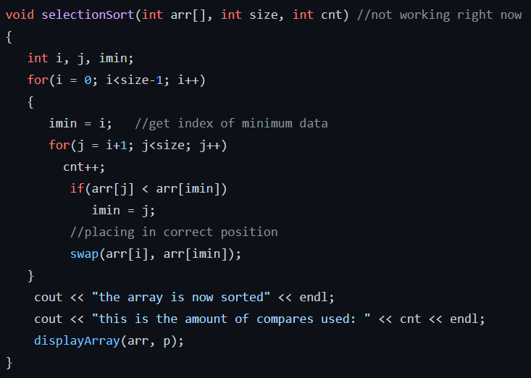
Selection
Image?
We used a standard selection sort code that gets the lowest number in the array .
We then swapped the smallest integer with one that’s higher to its left and kept iterating that until the list is sorted.

Slide 6
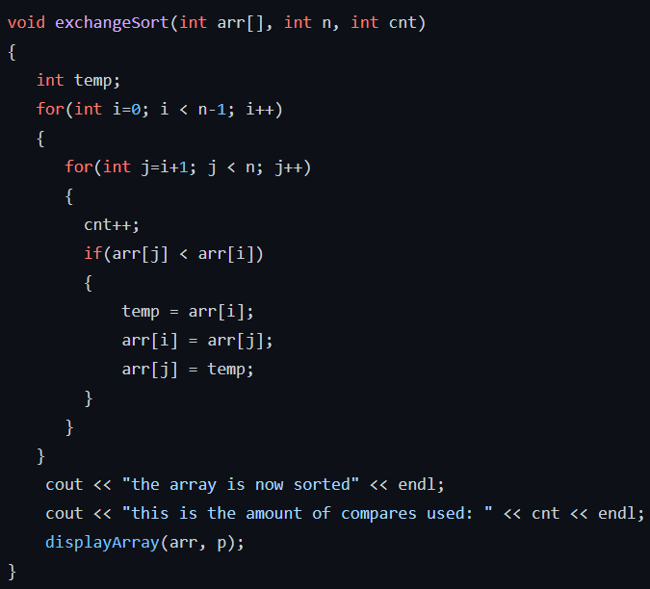
Exchange
Image?

Slide 7
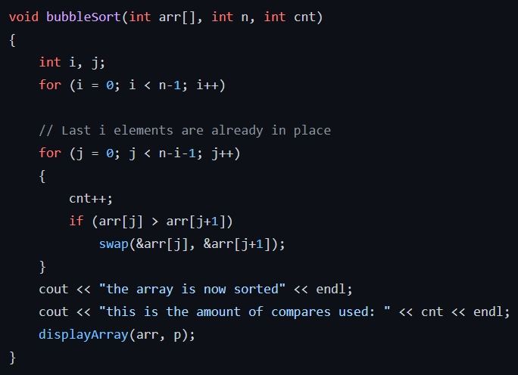
Bubble
Image?
For Bubble sort we used a basic algorithm that swaps the numbers from left to right switching their positions if they are not in the correct order.

Slide 8
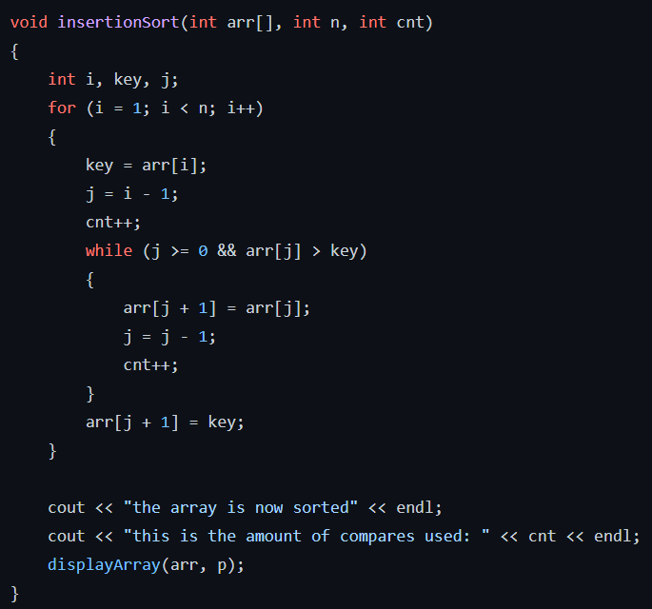
Insertion
Image?
We implemented a basic Insertion sort code that transfers the elements one at a time into their right position.

Slide 9
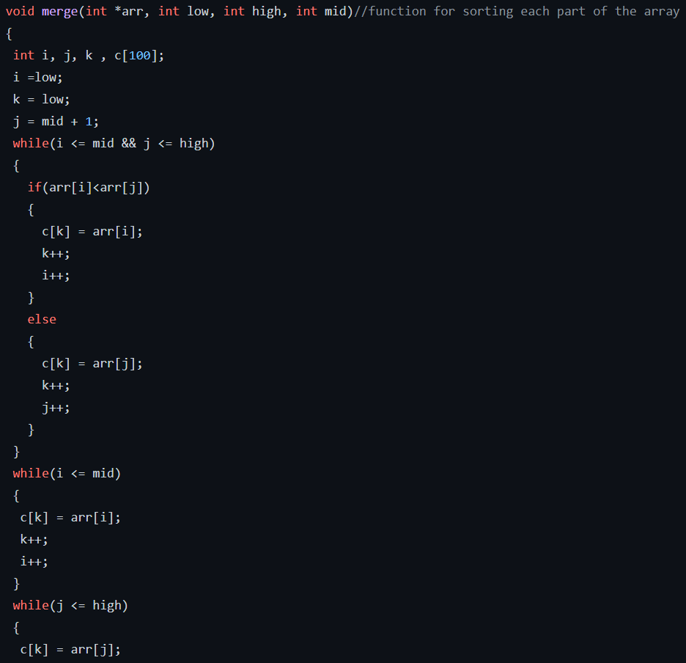
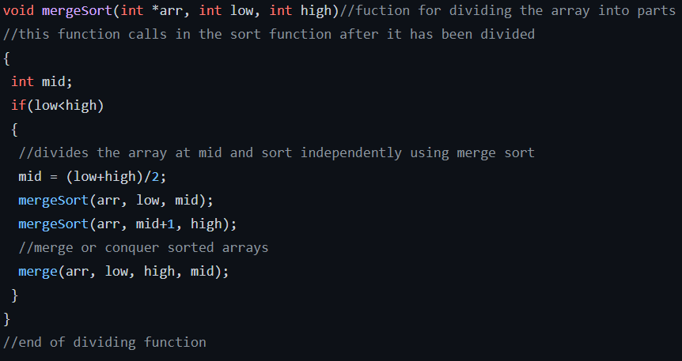
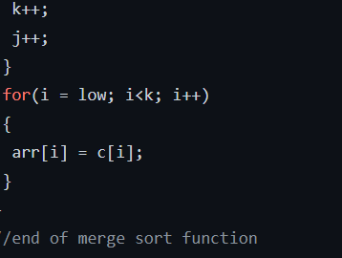
Merge
Image?
In this merge sort algorithm we had a function that divides the list up into pieces .
The dividing function divides the list into two halves, sorts each of the halves and then puts the two sorted halves together

Slide 10
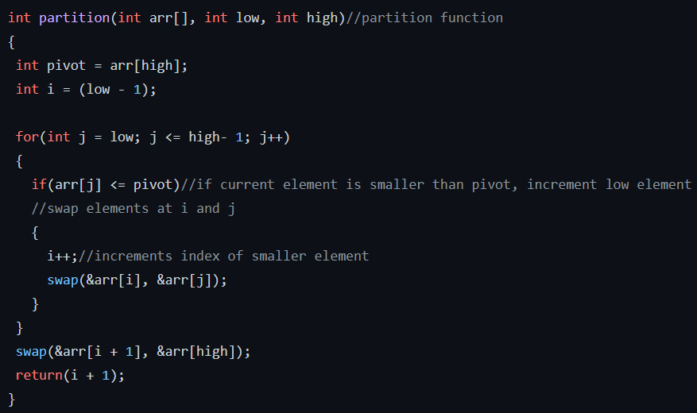
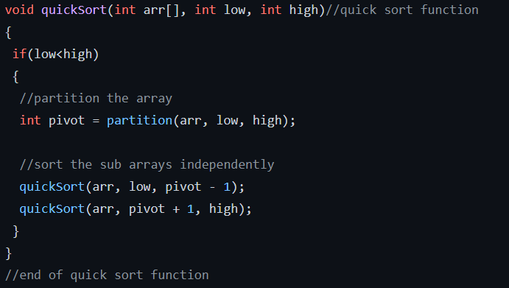
Quick
Image?
We implemented a basic quick sort algorithm which partitions the array into smaller arrays.
Similar to merge sort it then groups the sorted arrays into the final array which would be completely sorted.

Slide 11
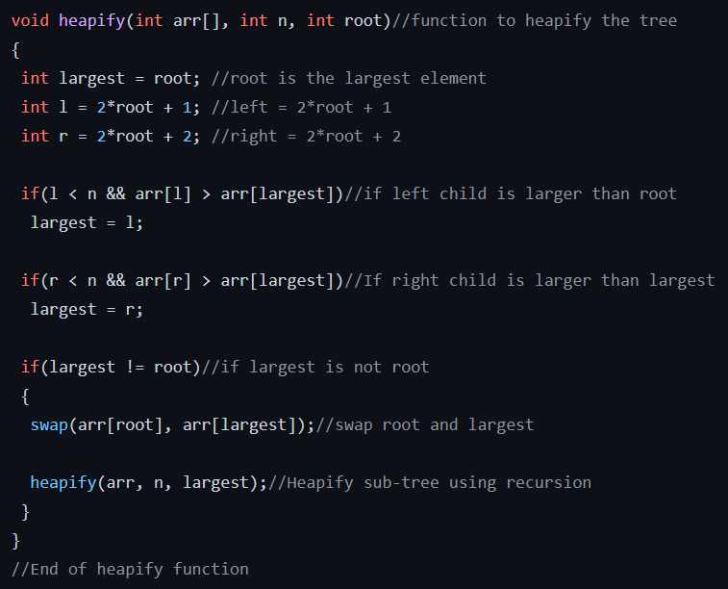
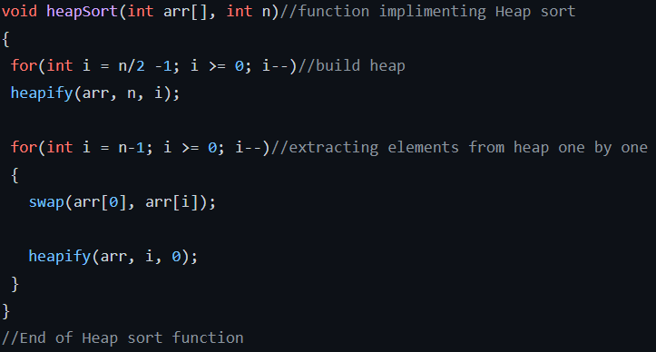
Heap
Image?
We implemented a basic Heap sort algorithm that builds heap from a given unsorted array and then uses the heap again to sort the array.

Slide 12
Our Success Rate
Thing
Other thing
Thing 2
Algorithm | Rate (%) | Failed (Y/N)
Selection | 82
Exchange | 76
Bubble | 84
Insertion
Merge
Quick
Heap

Slide 13
What We Learned
We got a better grasp at how each sort algorithm works and for which scenarios we should implement each sort in.
We also got a better idea of how to work in a team and present when given a big project like this for the future.

